Slide 1

Faculty of Engineering and Technology
PowerPulse :
A Data-Driven Approach
to Forecasting Electricity Demand
Name: Tanishka Dabas
Enr No. 0201220096
Name: Varish Jamal
Enr No. 0201220141
B Tech VII Sem DS
Name: Syed Irfan
Enr No. 0201220096
B Tech VII Sem DS
Guide: Mr. Raghunandan Hada
Coordinator: Prof. (Dr) Om Prakash Sharma

Slide 2

Faculty of Engineering and Technology
Table of Content
Introduction
Problem Statement
Project Objectives
Proposed Methodology
Software Requirements
Hardware Requirements
Expected Outcomes
Future Scopes
References

Slide 3
Faculty of Engineering and Technology
Introduction
Electricity consumption forecasting is essential for efficient energy planning and sustainable power management.
Accurate prediction of energy usage helps in reducing wastage, controlling costs, and ensuring proper resource allocation.
This project analyses historical electricity consumption data and develops a time-series forecasting model to predict future energy demand.
An interactive dashboard visualises trends and forecasted values.

Slide 4

Faculty of Engineering and Technology
Problem Statement
Electricity consumption varies due to seasonal and human factors
Traditional methods fail to capture complex patterns
Need for accurate, data-driven

Slide 5
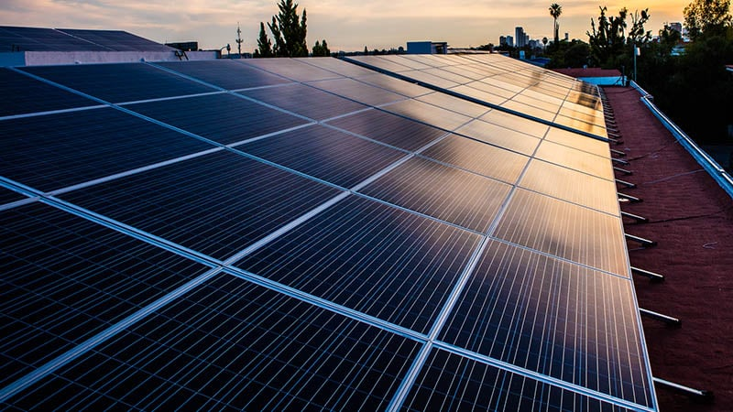
Faculty of Engineering and Technology
Existing Approaches/ Related Work
ARIMA (AutoRegressive Integrated Moving Average)
A statistical model for time series data. It's well-established and good for linear trends.
Exponential Smoothing
A time series forecasting method for univariate data. It's good for trends and seasonality and is adaptable to various data types.
Prophet (from Facebook)
A procedure for forecasting time series data based on an additive model where non-linear trends are fit with yearly, weekly, and daily seasonality, plus holiday effects.

Slide 6
Faculty of Engineering and Technology
Proposed Methodology
Data Collection
Data Preprocessing
EDA
Model (ARIMA / Prophet)
Forecast
Dashboard

Slide 7
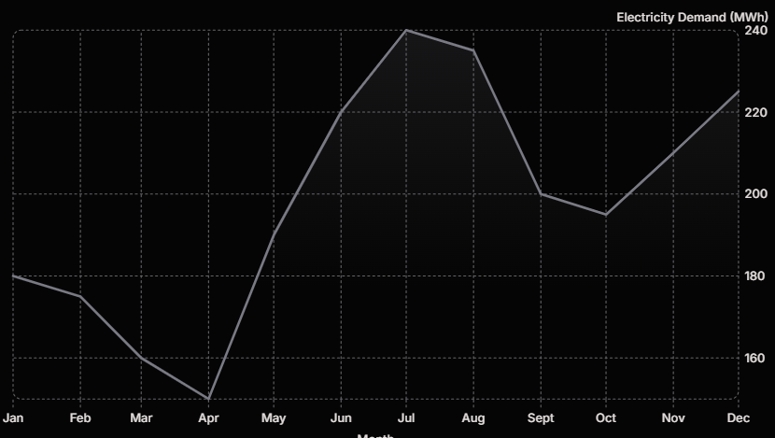
Faculty of Engineering and Technology
Results & Discussion
As evidenced by the results, the Prophet model consistently outperformed ARIMA across all evaluated metrics.
Prophet achieved lower RMSE, MAE, MAPE
Better handling of seasonality
More accurate real-world predictions.
This validates our data-driven approach and highlights Prophet's robustness in handling real-world time series challenges.
Metric | ARIMA | Prophet
RMSE | 15.2 | 12.8
MAE | 10.5 | 8.9
MAPE | 7.8% | 6.2%

Slide 8
Faculty of Engineering and Technology
Expected Outcomes
Forecasted Values
Accurate electricity consumption predictions for future periods using validated models
Anomaly Detection
Identification of unusual energy consumption patterns and outliers
Pattern Identification
Detection of seasonal patterns and consumption trends in energy usage data
Interactive Dashboard
User-friendly visualization interface for exploring historical data and forecasts

Slide 9
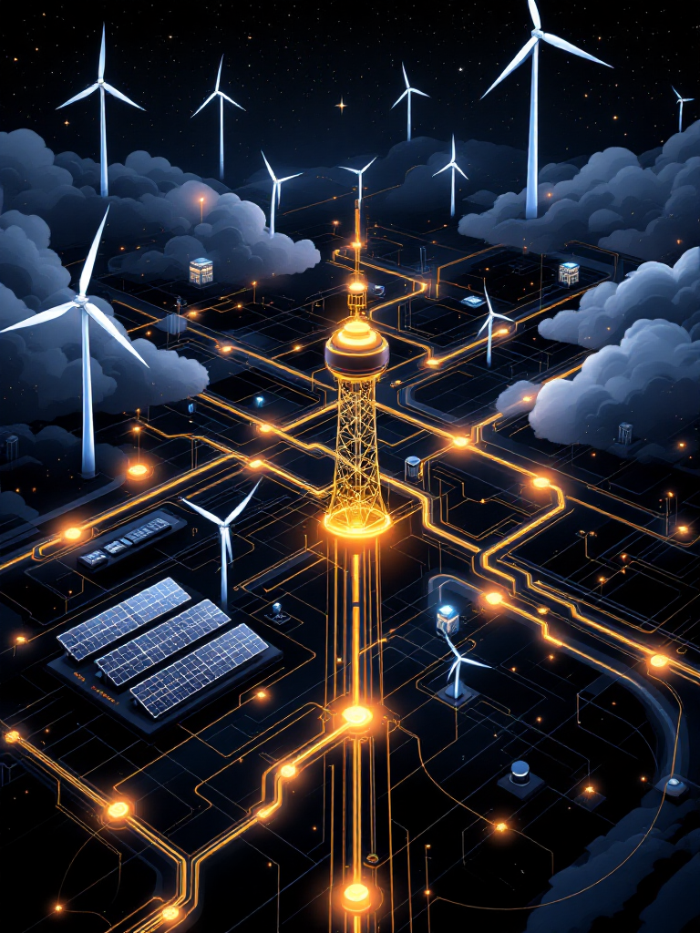
Faculty of Engineering and Technology
Future Scopes
Real-Time Integration
Integration with live smart meter data for continuous forecasting
Deep Learning Models
Implementation of advanced LSTM neural networks for improved accuracy
Web Application
Deployment as scalable web-based service for broader accessibility

Slide 10
Faculty of Engineering and Technology
References
Box, G. E. P., Jenkins, G. M., Reinsel, G. C., & Ljung, G. M. (2015). Time Series Analysis: Forecasting and Control (5th ed.). Wiley. (Classic reference for ARIMA models)
Taylor, S. J., & Letham, B. (2018). Forecasting at Scale. The American Statistician, 72(1), 37–45. (Introduces the Prophet forecasting model by Facebook)
Hyndman, R. J., & Athanasopoulos, G. (2018). Forecasting: Principles and Practice (2nd ed.). OTexts. (Comprehensive guide to forecasting methods, including ARIMA and other time series techniques)
Hong, T., Pinson, P., & Fan, S. (2016). Global Energy Forecasting Competition 2014: Wind and Solar Forecasting. International Journal of Forecasting, 32(3), 898–907. (Relevant work in energy forecasting competitions and methodologies)
Ahmed, N., Al-Fuqaha, A., & Guizani, M. (2020). Machine Learning for Electricity Demand Forecasting: A Review. IEEE Access, 8, 172901–172918. (Review of machine learning techniques applied to electricity demand forecasting)

Slide 11
Faculty of Engineering and Technology
Thank You

